Slide 1
Freeman’s Network Centralization

Slide 2
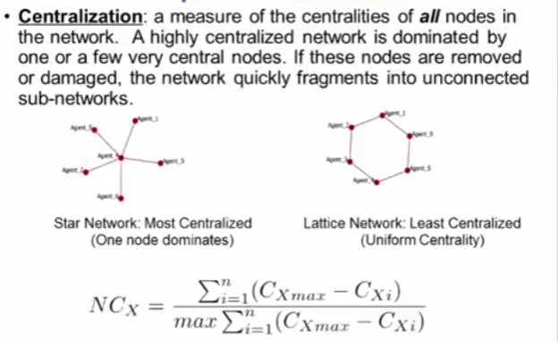

Slide 3
Centralisation
The centralization of any network is a measure of how central its most central node is in relation to how central all the other nodes are.
Centralization measures then
calculate the sum in differences in centrality between the most central node in a network and all other nodes; and
divide this quantity by the theoretically largest such sum of differences in any network of the same size

Slide 4
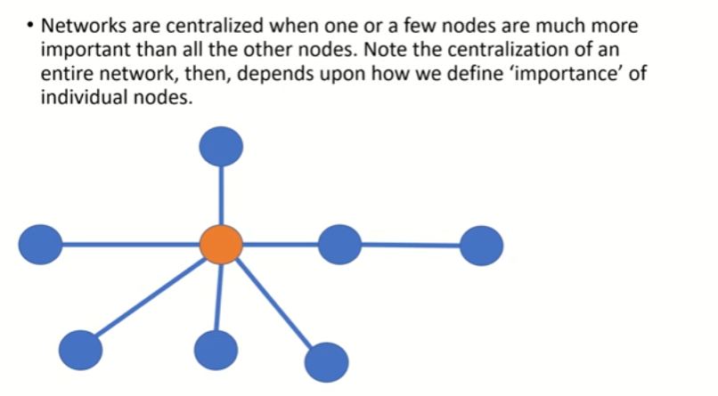

Slide 5
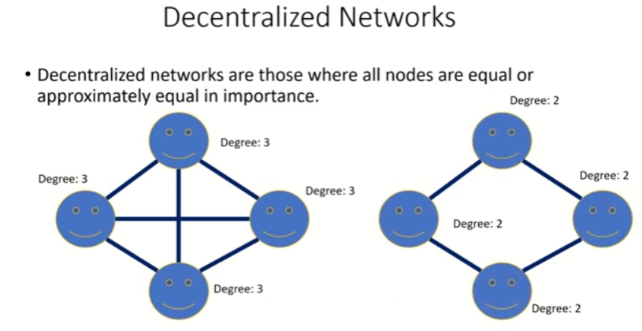

Slide 6
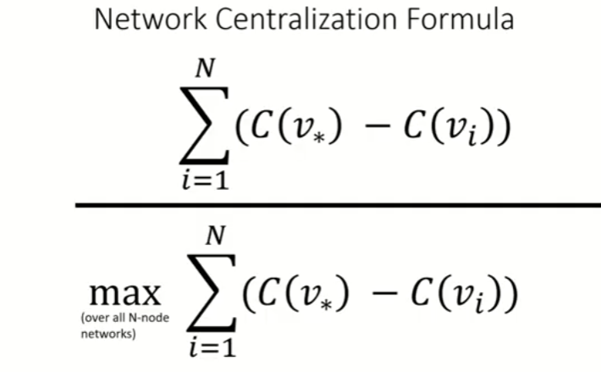
Network Centralization formula

Slide 7
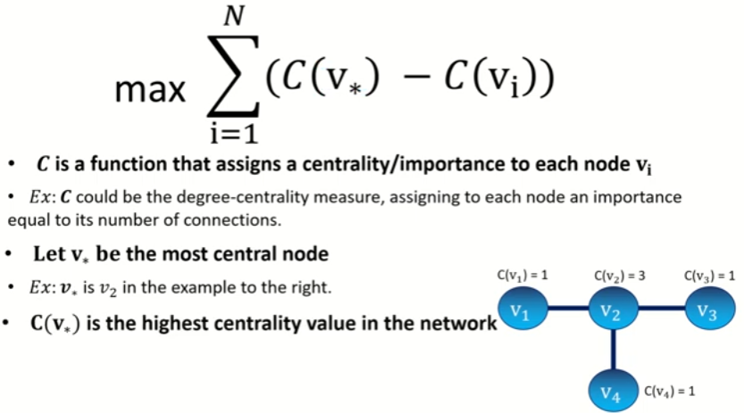
Formula … contd.

Slide 8
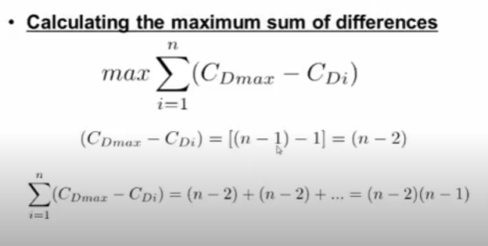

Slide 9
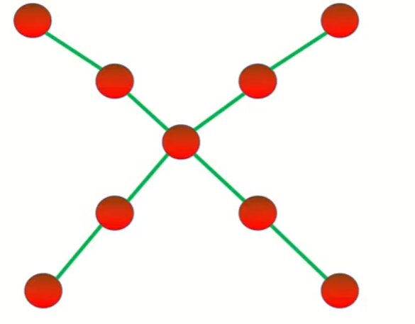
Example 1 : Network centralization

Slide 10
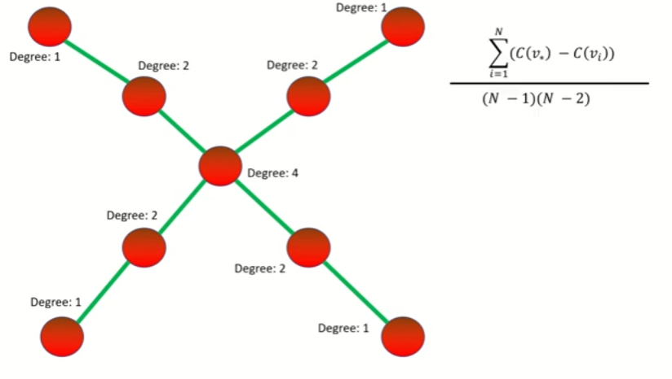
Step 1: Find the degree centrality of the nodes

Slide 11
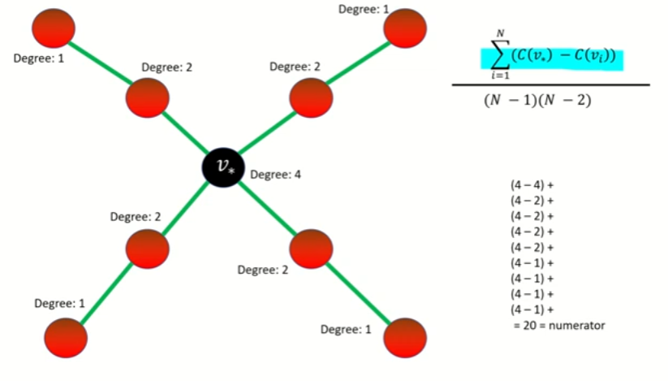
Step 2: Calculating and Substituting for the numerator

Slide 12
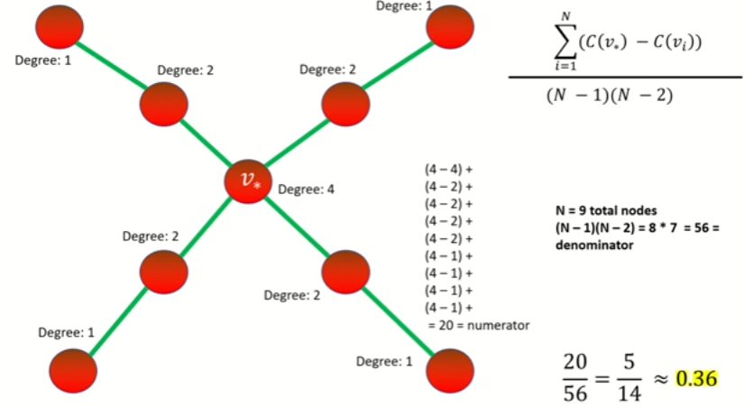
Step 3: Calculating and Substituting for the denominator

Slide 13
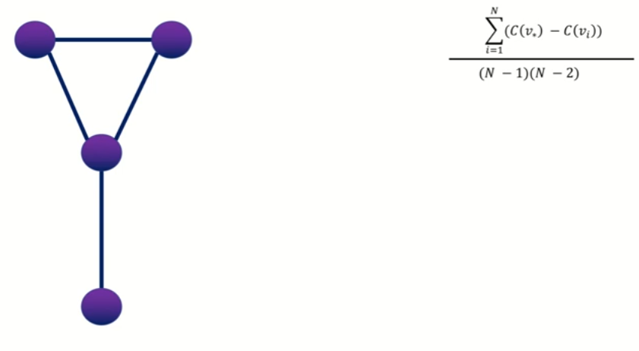
Example 2 : Network centralization

Slide 14
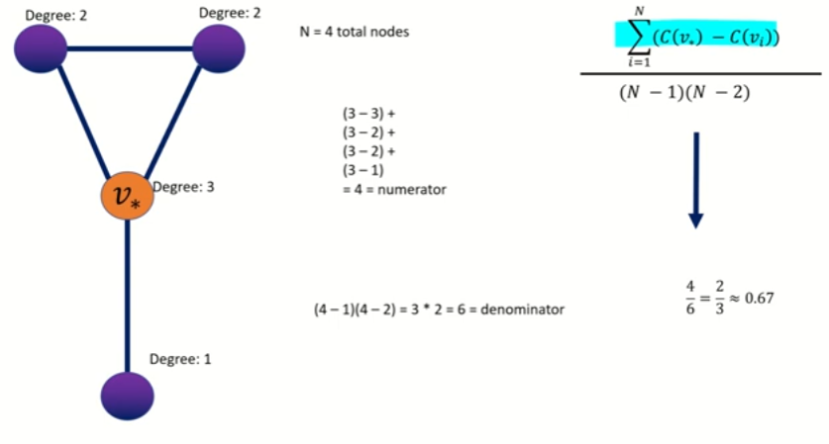
Calculation and Substitution

Slide 15
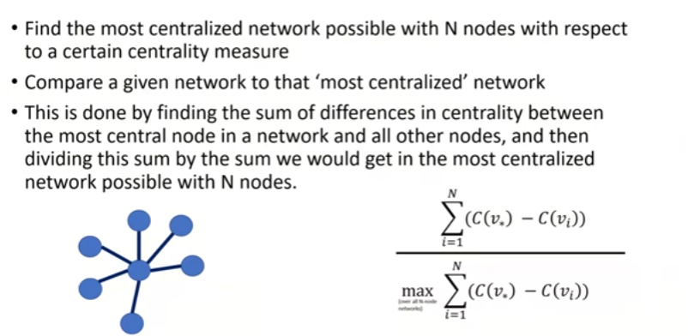
Summary

